Slide 1
Community Engagement & Corporate Identity Program

Slide 2
Website Analytics August, September, October 2017

Slide 3
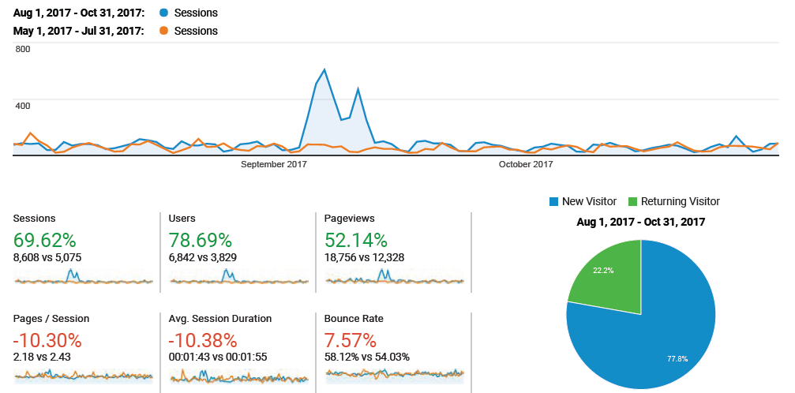
Audience - Overview

Slide 4
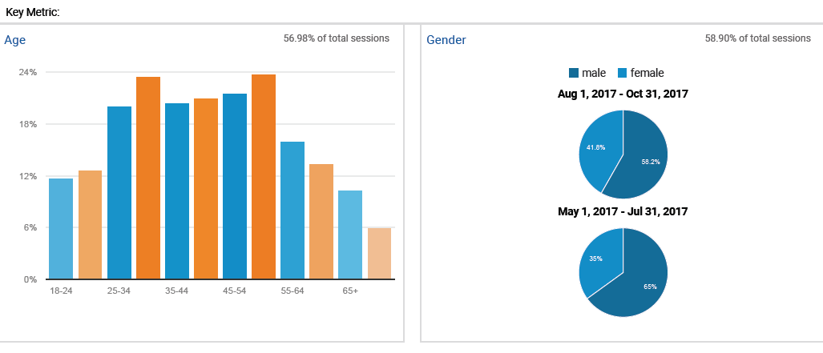
Demographic - Overview

Slide 5
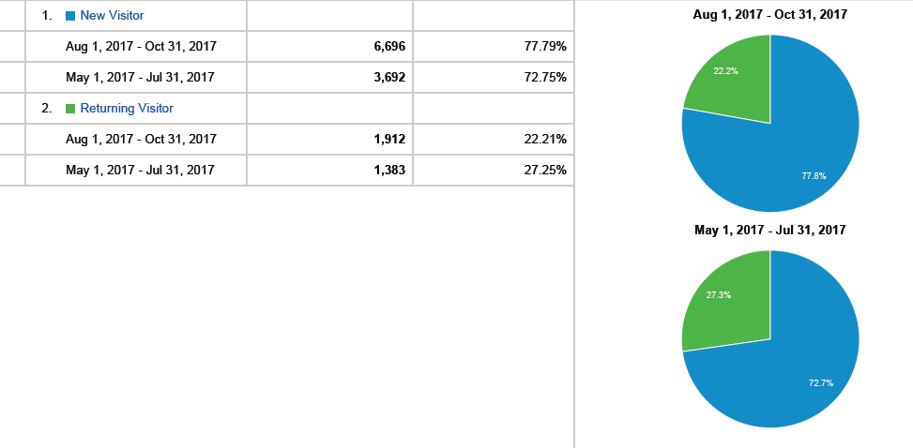
New vs Returning Visitors - Overview

Slide 6
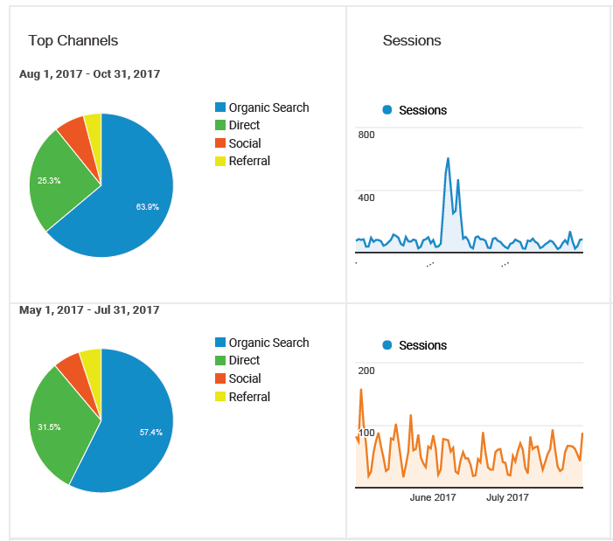
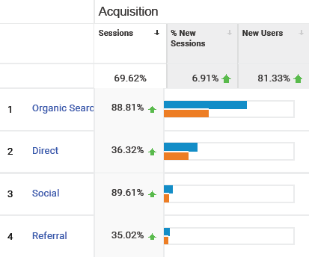
Referral - Overview

Slide 7
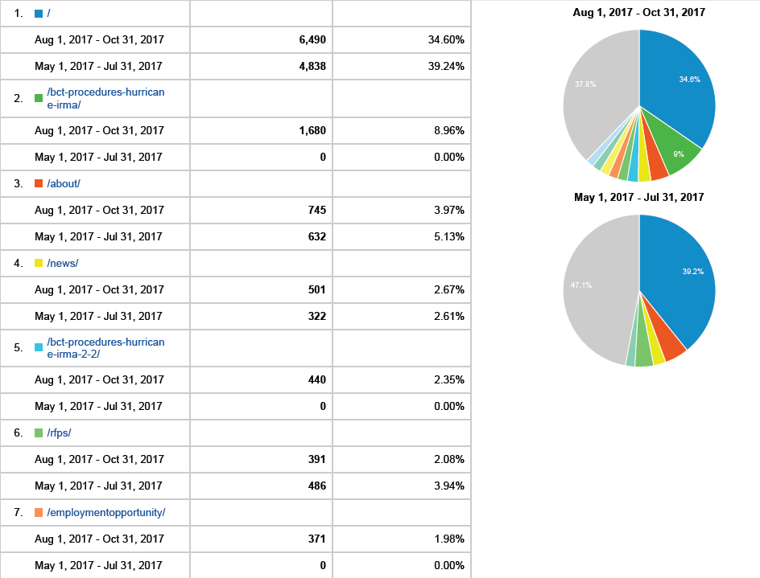
Page Traffic - Overview

Slide 8
Social Media Review August, September, October 2017

Slide 9
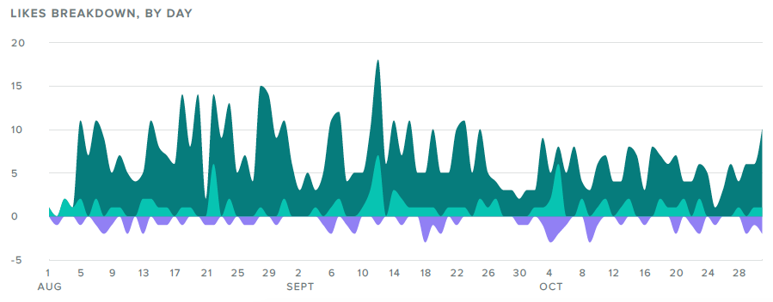
Facebook Activity - Overview

Slide 10
Facebook Posts- Overview

Slide 11
Facebook Impressions

Slide 12
Facebook Engagement

Slide 13
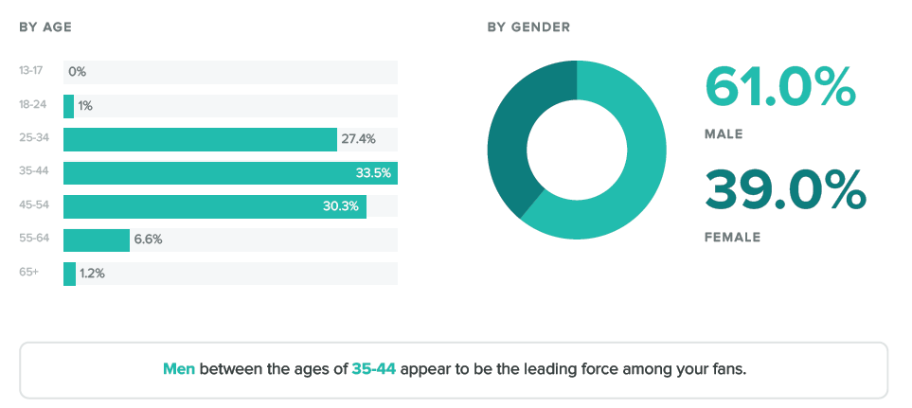
Facebook Fan Demographics

Slide 14
Facebook Statistics

Slide 15
Community Engagement Q4 2017 and Beyond

Slide 16
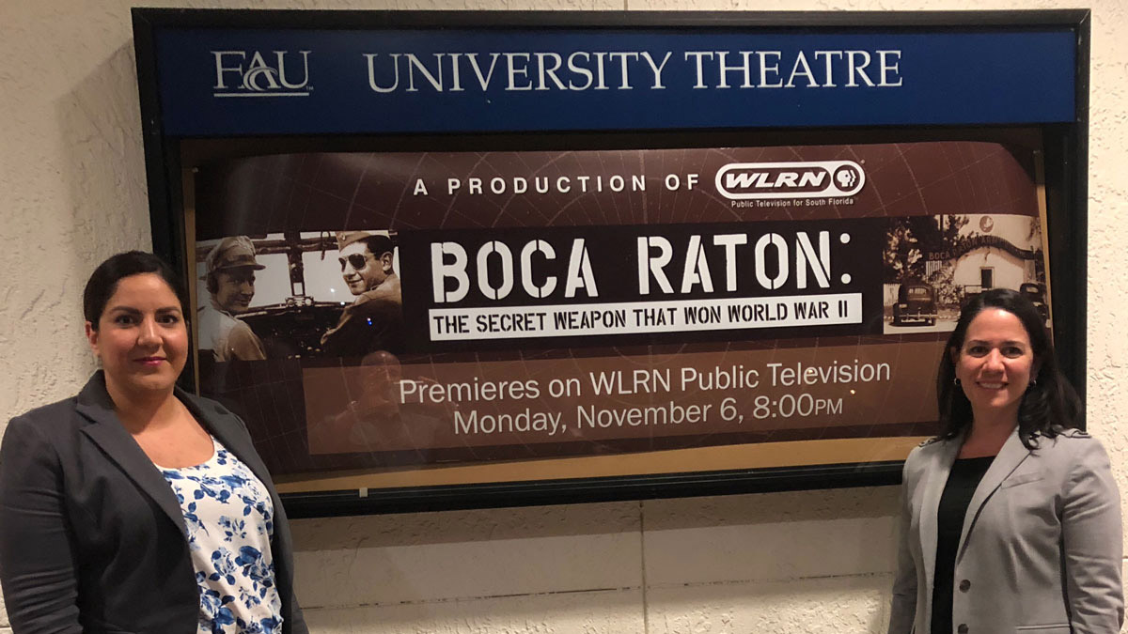
Boca Raton: The Secret Weapon That Won World War II

Slide 17
Toy for Tots
Press release
Blog article
Social Media
Signage

Slide 18
US Customs & Border Protection
Pre and Post Opening Public Relations
Press releases – long and short lead time, Blog articles, Social media content
Opening event planning
Invites, Media relations, Catering, Event coordination
Lobby Video and Signage
“Now Open” creative materials for Air and Marine industries
Flyers, Promotional brochure, Rate cards
Website content for end users

Slide 19
Additional PR Initiatives
EMAS Updates
Capital Improvements
Student Tours

Slide 20
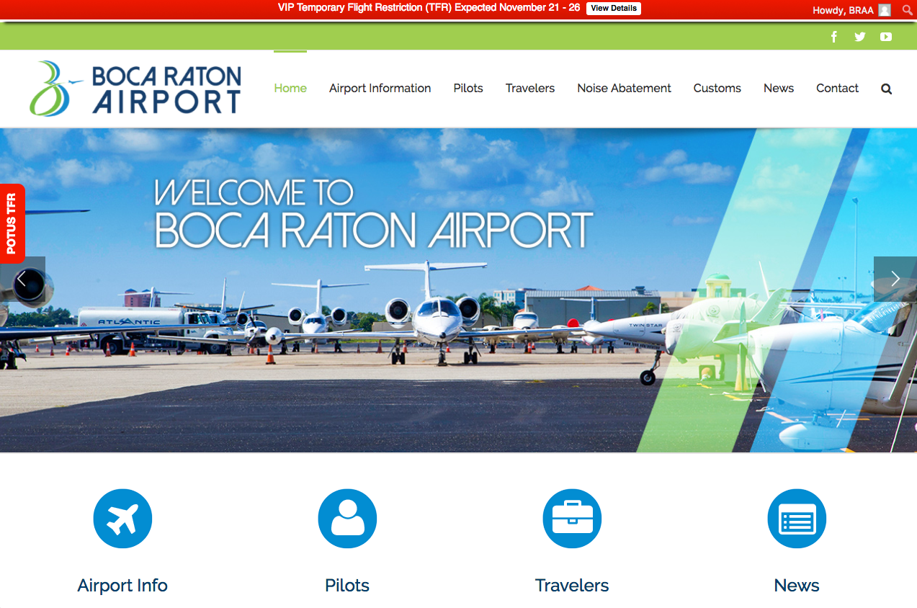
Creative Projects
Updated Task Sheets
EMAS
Tower Updates
Airport Road Improvements
Videos
Short Tour Video
Long Tour Chaptered Videos
Website additions
Tenant Directory
Special Event Appliations

