Slide 1
Community Engagement & Corporate Identity Program

Slide 2
Website Analytics November, December 2017 January 2018

Slide 3
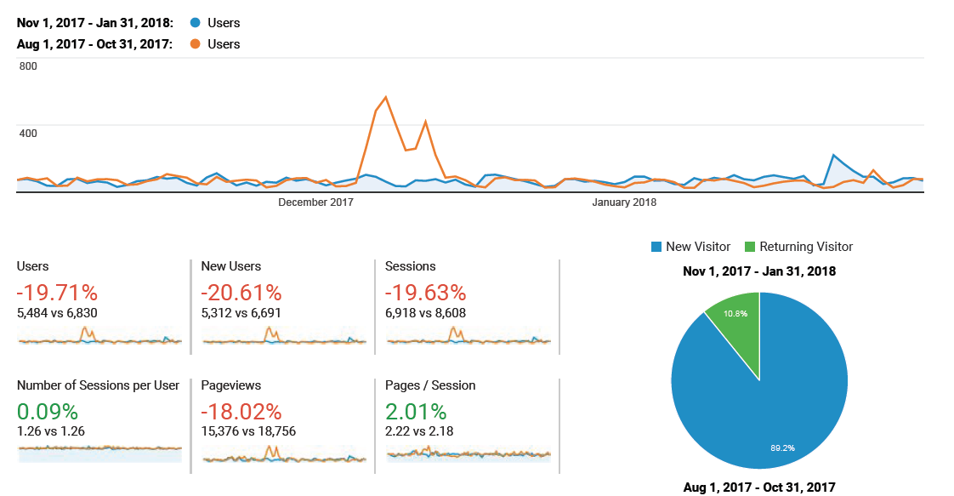
Audience - Overview

Slide 4
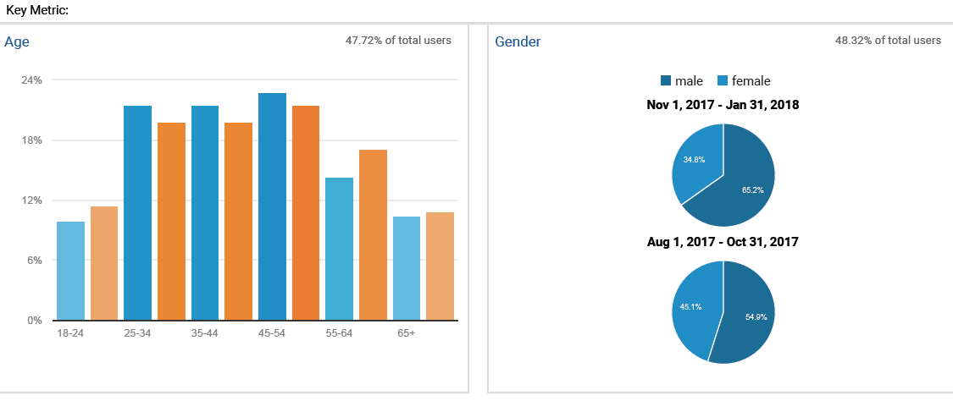
Demographic - Overview

Slide 5
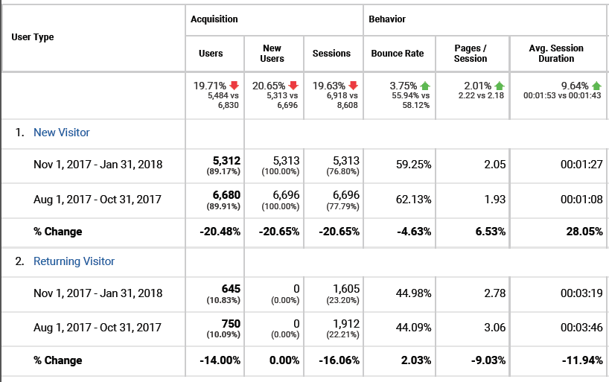
New vs Returning Visitors - Overview

Slide 6
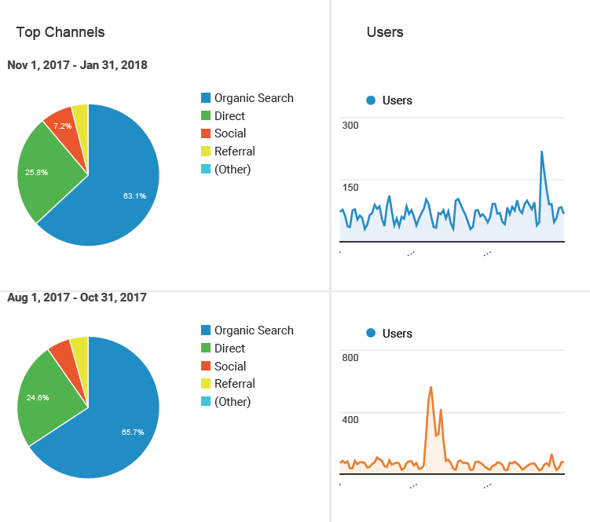
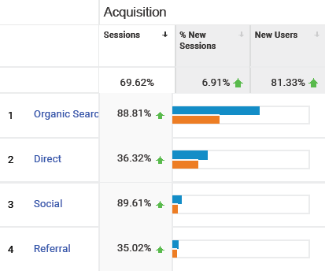
Referral - Overview

Slide 7
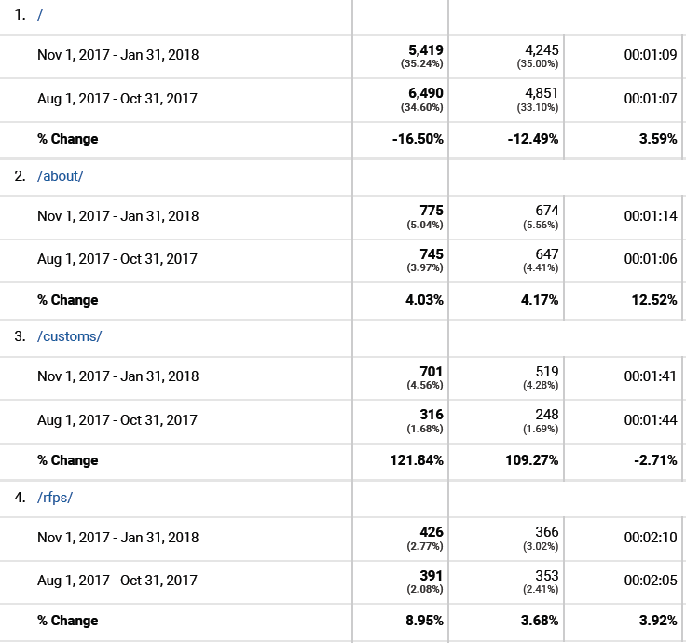
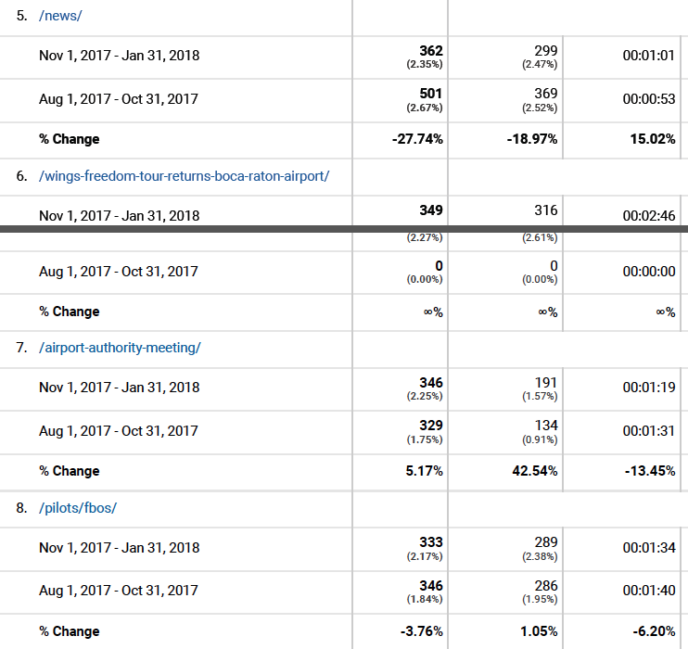
Page Traffic - Overview

Slide 8
Social Media Review November, December 2017 January 2018

Slide 9
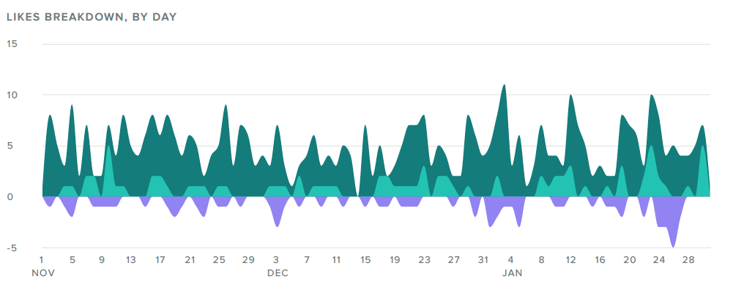
Facebook Activity - Overview

Slide 10
Facebook Posts- Overview

Slide 11
Facebook Impressions

Slide 12
Facebook Engagement

Slide 13
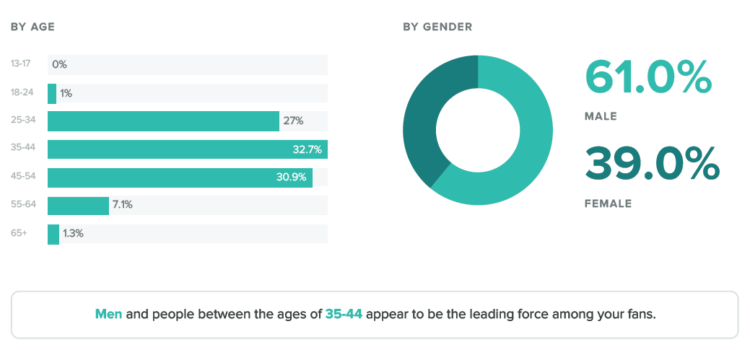
Facebook Fan Demographics

Slide 14
Facebook Statistics

Slide 15
Community Engagement November, December 2017 January 2018

Slide 16
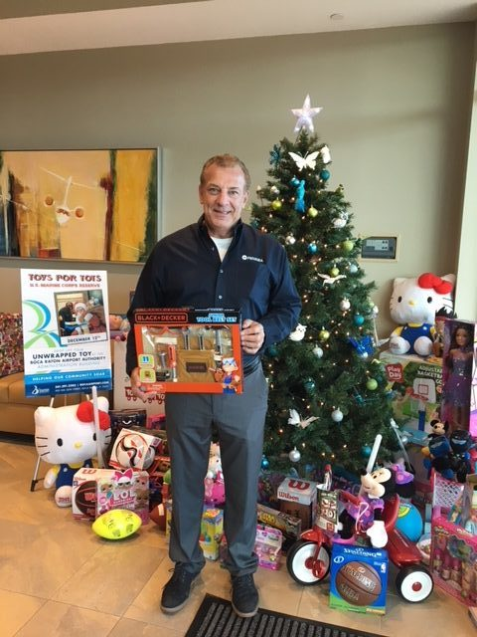
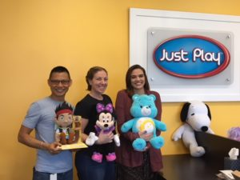
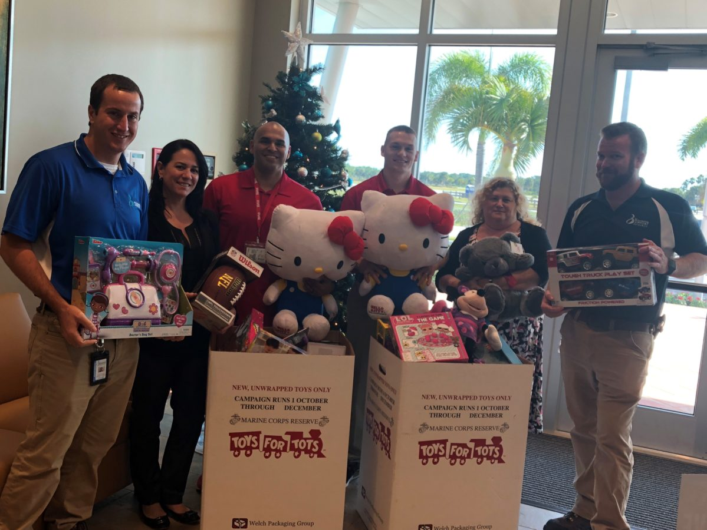
Toys for Tots 2017

Slide 17
Wings of Freedom 2018

Slide 18
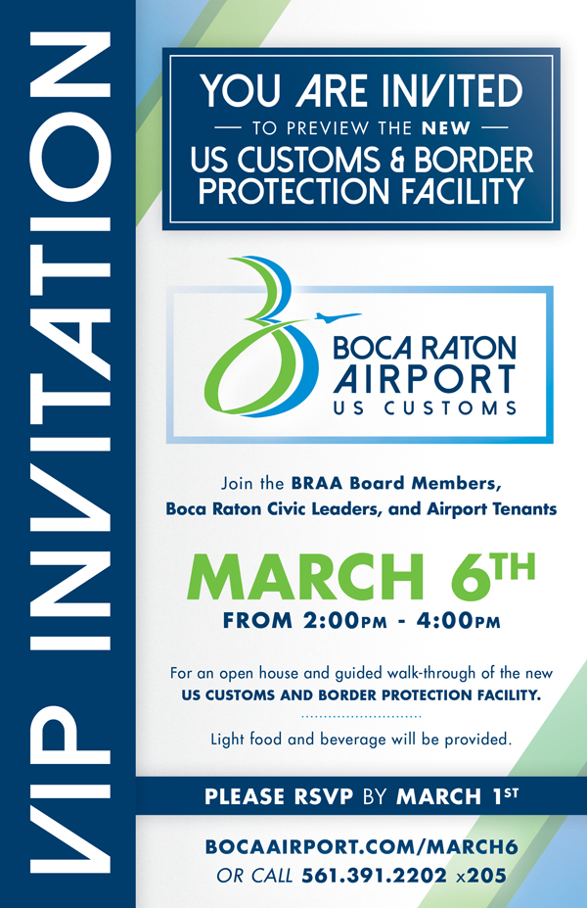
US Customs & Border Protection

Slide 19
Boca Raton Airport: Tour Video

Slide 20
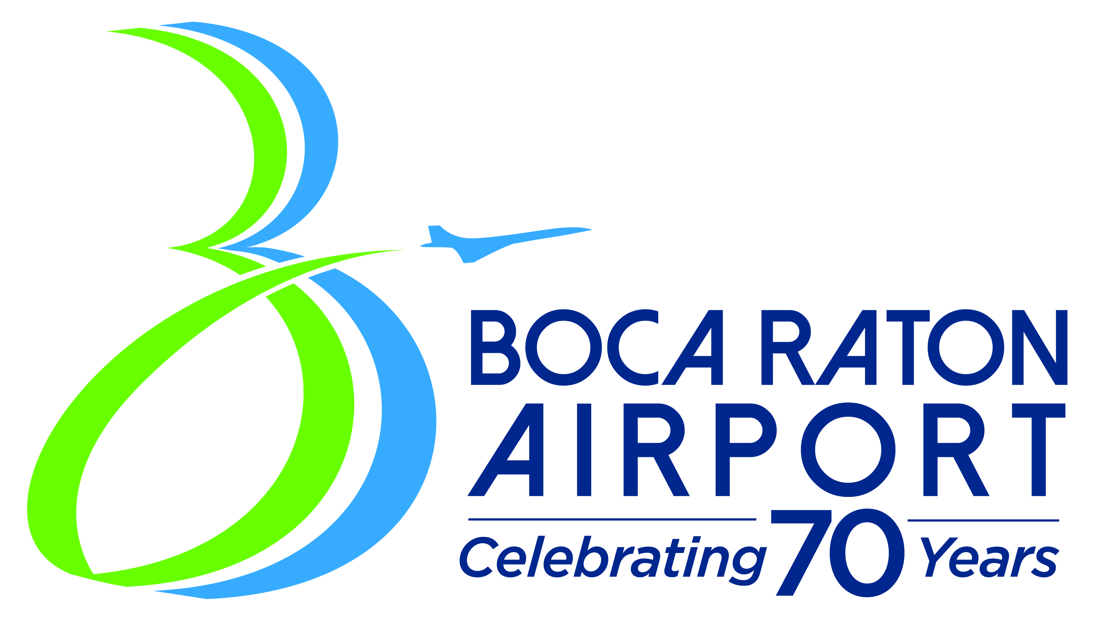
Celebrating 70 Years

Slide 21
Celebrating 70 Years
Q1: Logo Release
Q2: Celebrating the History
Q3: Celebrating Community
Q4: Celebrating into the Future

Slide 22
PR Initiatives and Releases
Boca Raton Air Traffic Control Tower Rehabilitation: Phase II to Begin in 2018
AviationPros.com
Installation of Arresting System Completed at the Boca Raton Airport
Aviation International News
BocaNewsNow.com
The Boca Raton Tribune
Wings Journal

